Slide 1
DATA MINING LECTURE 1
Introduction
Heba AL.Marwai

Slide 2
What is data mining?
After years of data mining there is still no unique answer to this question.
A tentative definition:
Data mining is the use of efficient techniques for the analysis of very large collections of data and the extraction of useful and possibly unexpected patterns in data.

Slide 3
What is Data Mining?
Data Mining is:
(1) The efficient discovery of previously unknown, valid, potentially useful, understandable patterns in large datasets
(2) The analysis of (often large) observational data sets to find unsuspected relationships and to summarize the data in novel ways that are both understandable and useful to the data owner

Slide 4
Overview of terms
Data: a set of facts (items) D, usually stored in a database
Pattern: an expression E in a language L, that describes a subset of facts
Attribute: a field in an item i in D.
Interestingness: a function ID,L that maps an expression E in L into a measure space M

Slide 5
Origins of Data Mining
Draws ideas from machine learning/AI, pattern recognition, statistics, and database systems
Must address:
Enormity of data
High dimensionality of data
Heterogeneous, distributed nature of data
AI /
Machine Learning
Statistics
Data Mining
Database systems

Slide 6
Why do we need data mining?
Really, really huge amounts of raw data!!
In the digital age, TB of data is generated by the second
Mobile devices, digital photographs, web documents.
Facebook updates, Tweets, Blogs, User-generated content
Transactions, sensor data.
Queries, clicks, browsing
Cheap storage has made possible to maintain this data
Need to analyze the raw data to extract knowledge

Slide 7
Why do we need data mining?
“The data is the computer”
Large amounts of data can be more powerful than complex algorithms and models
Google has solved many Natural Language Processing problems, simply by looking at the data
Example: misspellings, synonyms
Data is power!
Today, the collected data is one of the biggest assets of an online company
Query logs of Google
The friendship and updates of Facebook
Tweets and follows of Twitter
We need a way to harness the collective intelligence

Slide 8
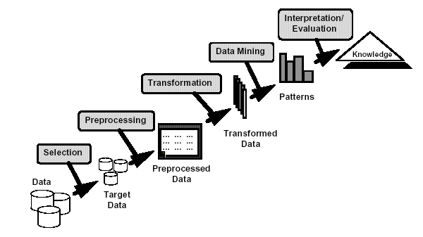
Knowledge Discovery

Slide 9
The Data Mining Process
1. Understand the domain
2. Create a dataset:
Select the interesting attributes
Data cleaning and preprocessing
3. Choose the data mining task and the specific algorithm
4. Interpret the results, and possibly return to 2

Slide 10
Data Mining Tasks
1. Classification: learning a function that maps an item into one of a set of predefined classes
2. Regression: learning a function that maps an item to a real value
3. Clustering: identify a set of groups of similar items

Slide 11
Data Mining Tasks
4. Dependencies and associations:
identify significant dependencies between data attributes
5. Summarization: find a compact description of the dataset or a subset of the dataset

Slide 12
The data is also very complex
Multiple types of data: tables, time series, images, graphs, etc
Interconnected data of different types:
From the mobile phone we can collect, location of the user, friendship information, opinions through twitter, images though cameras, queries to search engines

Slide 13
So, what is Data?
Attributes
Collection of data objects and their attributes
An attribute is a property or characteristic of an object
Examples: eye color of a person, temperature, etc.
Attribute is also known as variable, field, characteristic, or feature
A collection of attributes describe an object
Object is also known as record, point, case, sample, entity, or instance
Objects
Size: Number of objects
Dimensionality: Number of attributes
Sparsity: Number of populated
object-attribute pairs

Slide 14
Types of Attributes
There are different types of attributes
Categorical
Examples: eye color, zip codes, words, rankings (e.g, good, fair, bad), height in {tall, medium, short}
Nominal (no order or comparison) vs Ordinal (order )
Numeric
Examples: dates, temperature, time, length, value, count.
Discrete (counts) vs Continuous (temperature)
Special case: Binary attributes (yes/no, exists/not exists)

Slide 15
Numeric Record Data
If data objects have the same fixed set of numeric attributes, then the data objects can be thought of as points in a multi-dimensional space, where each dimension represents a distinct attribute
Such data set can be represented by an n-by-d data matrix, where there are n rows, one for each object, and d columns, one for each attribute

Slide 16
Categorical Data
Data that consists of a collection of records, each of which consists of a fixed set of categorical attributes

Slide 17
Document Data
Each document becomes a `term' vector,
each term is a component (attribute) of the vector,
the value of each component is the number of times the corresponding term occurs in the document.
Bag-of-words representation – no ordering

Slide 18
Transaction Data
Each record (transaction) is a set of items.
A set of items can also be represented as a binary vector, where each attribute is an item.
A document can also be represented as a set of words (no counts)
Sparsity: average number of products bought by a customer

Slide 19
Ordered Data
Genomic sequence data
Data is a long ordered string

Slide 20
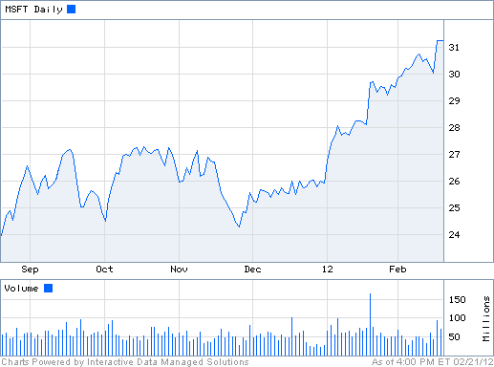
Ordered Data
Time series
Sequence of ordered (over “time”) numeric values.

Slide 21
Graph Data
Examples: Web graph and HTML Links

Slide 22
Types of data
Numeric data: Each object is a point in a multidimensional space
Categorical data: Each object is a vector of categorical values
Set data: Each object is a set of values (with or without counts)
Sets can also be represented as binary vectors, or vectors of counts
Ordered sequences: Each object is an ordered sequence of values.
Graph data

Slide 23
What can you do with the data?
Suppose that you are the owner of a supermarket and you have collected billions of market basket data. What information would you extract from it and how would you use it?
What if this was an online store?
Product placement
Catalog creation
Recommendations

Slide 24
What can you do with the data?
Suppose you are a search engine and you have a toolbar log consisting of
pages browsed,
queries,
pages clicked,
ads clicked
each with a user id and a timestamp. What information would you like to get our of the data?
Ad click prediction
Query reformulations

Slide 25
What can you do with the data?
You are the owner of a social network, and you have full access to the social graph, what kind of information do you want to get out of your graph?
Who is the most important node in the graph?
What is the shortest path between two nodes?
How many friends two nodes have in common?
How does information spread on the network?

Slide 26
Why data mining?
Commercial point of view
Data has become the key competitive advantage of companies
Examples: Facebook, Google, Amazon
Being able to extract useful information out of the data is key for exploiting them commercially.
Scientific point of view
Scientists are at an unprecedented position where they can collect TB of information
Examples: Sensor data, astronomy data, social network data, gene data
We need the tools to analyze such data to get a better understanding of the world and advance science
Scale (in data size and feature dimension)
Why not use traditional analytic methods?
Enormity of data, curse of dimensionality
The amount and the complexity of data does not allow for manual processing of the data. We need automated techniques.

Slide 27
Why Data Preprocessing?
Data in the real world is dirty
incomplete: lacking attribute values, lacking certain attributes of interest .
noisy: containing errors or outliers
inconsistent: containing discrepancies in codes or names
No quality data, no quality mining results!
Quality decisions must be based on quality data
Data warehouse needs consistent integration of quality data
Required for both OLAP and Data Mining!

Slide 28
Why can Data be Incomplete?
Attributes of interest are not available (e.g., customer information for sales transaction data)
Data were not considered important at the time of transactions, so they were not recorded!
Data not recorder because of misunderstanding or malfunctions
Data may have been recorded and later deleted!
Missing/unknown values for some data

Slide 29
Data Cleaning
Data cleaning tasks
Fill in missing values
Identify outliers and smooth out noisy data
Correct inconsistent data

Slide 30
What can we do with data mining?
Some examples:
Frequent itemsets and Association Rules extraction
Clustering
Classification
Ranking
Exploratory analysis

